Slide 1

Customer
Segmentation
using
K_means
cluster
Company Customer

Slide 2

Steps for this data:
Data Exploration : Understanding the Data
Data visualization
Data Preprocessing: Handling Missing Values ,Encoding Categorical Variables, Scaling/Normalization
Clustering
Evaluating model
Visualization model
Refinement and Application

Slide 3
What is dataset about?
An automobile company has plans to enter new markets with their existing products (P1, P2, P3, P4 and P5). After intensive market research, they’ve deduced that the behavior of new market is similar to their existing market.
In their existing market, the sales team has classified all customers into 4 segments (A, B, C, D ). Then, they performed segmented outreach and communication for different segment of customers. This strategy has work exceptionally well for them. They plan to use the same strategy on new markets and have identified 2627 new potential customers.

Slide 4
Describe the columns:
Unnamed: 0: This column seems to represent an index or identifier for each row in the dataset. It doesn't seem to have a specific label or meaning associated with it.
ID: This column likely represents a unique identifier or ID number for each individual in the dataset. Each person seems to have a distinct ID number.
Gender: This column represents the gender of each individual, categorized as 'Male' or 'Female'.
Ever_Married: Indicates whether the individual has ever been married, categorized as 'Yes' or 'No'.
Age: Represents the age of each individual.
Graduated: Indicates whether the individual has graduated from an educational institution, categorized as 'Yes' or 'No'.
Profession: Specifies the profession or occupation of each individual.
Work_Experience: Represents the number of years of work experience for each individual.
Spending_Score: Represents a spending score category, potentially based on the individual's spending habits, categorized as 'Low', 'Medium', or 'High'. In this dataset, all values are 'Low'.
Family_Size: Indicates the size of the individual's family.
Var_1: This column seems to contain categorical variables or labels (such as 'Cat_6', 'Cat_4', etc.), possibly representing different categories or types.
Segmentation: Represents the segmentation category or group that the individual belongs to, categorized as 'A', 'B', 'C', or 'D'.

Slide 5
Important libraries
import pandas as pd
import numpy as np
import seaborn as sns
import matplotlib.pyplot as plt
from sklearn.preprocessing import LabelEncoder, StandardScaler
from sklearn.cluster import KMeans

Slide 6
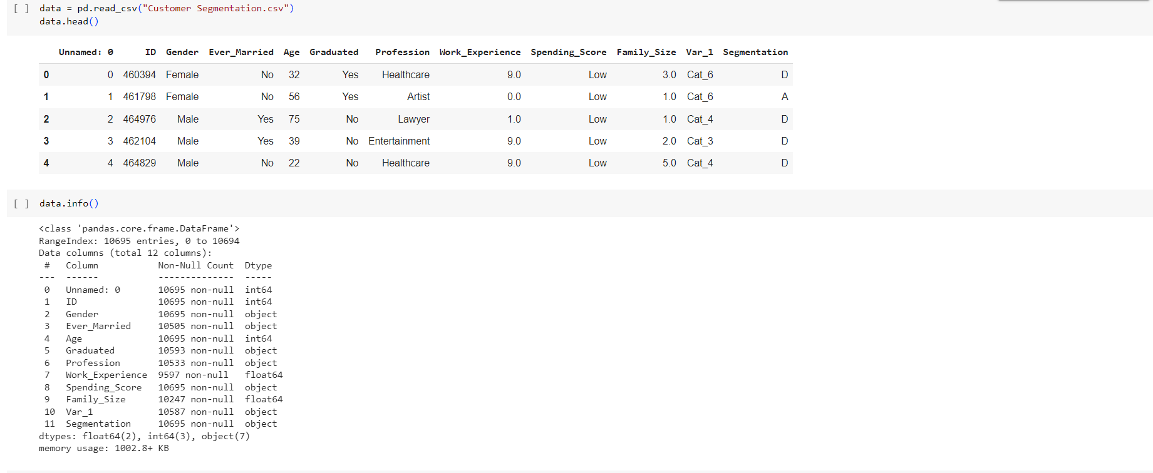
Data Exploration
data = pd.read_csv("Customer Segmentation.csv"): The pd.read_csv() function is used to read a CSV file and create a DataFrame named 'data' with the contents of the CSV file.
data.info() method in pandas is used to print a concise summary of a DataFrame, including information about the data types, non-null values, and memory usage.
data.describe() method in pandas is used to generate descriptive statistics of a DataFrame
for col in data.select_dtypes(include=['object']).columns: print(f'Unique values in {col}: {data[col].unique()}’) , the code assumes that the columns with data type 'object' are categorical columns, and it prints the unique values for each of these columns in the DataFrame.
(data.isnull().sum()) , used to count the number of missing values in each column of a pandas DataFrame.

Slide 7
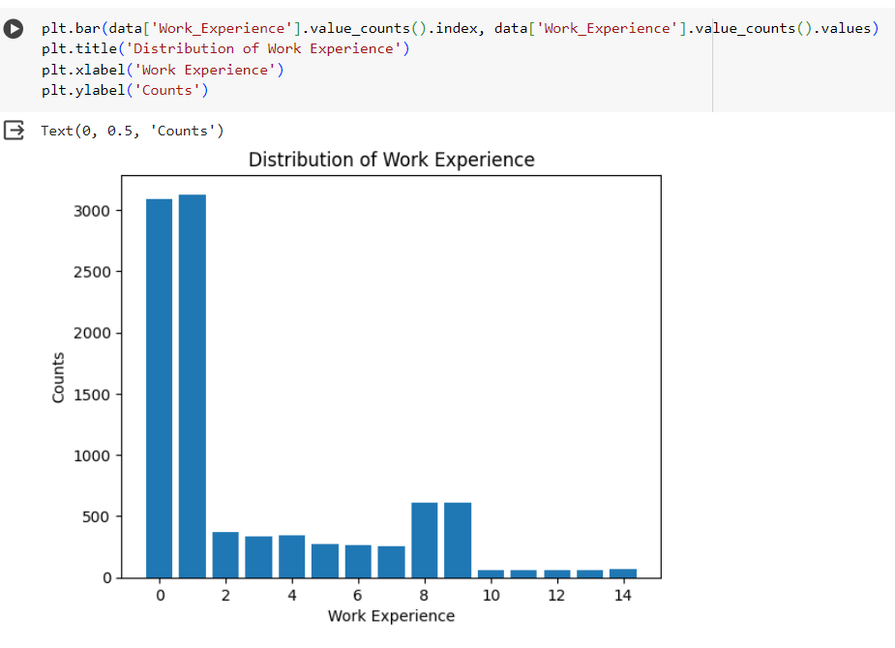
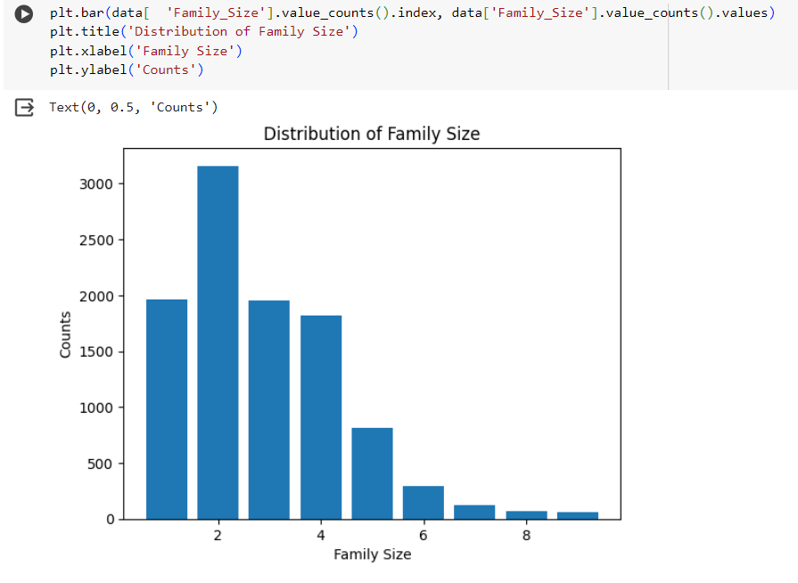
Data visualization

Slide 8
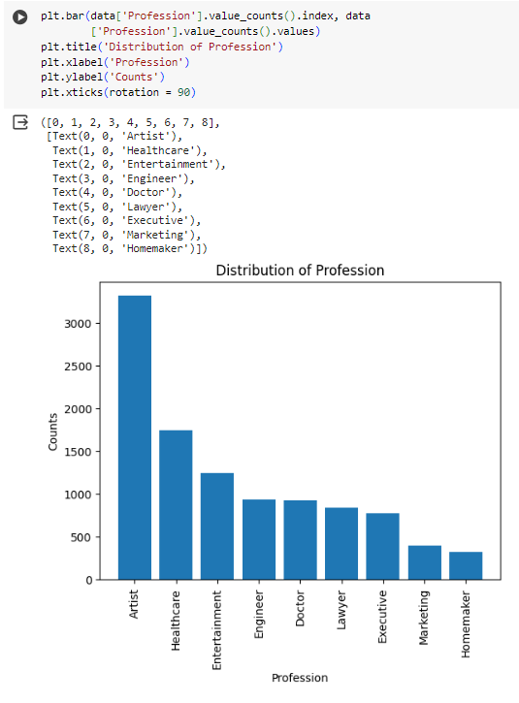
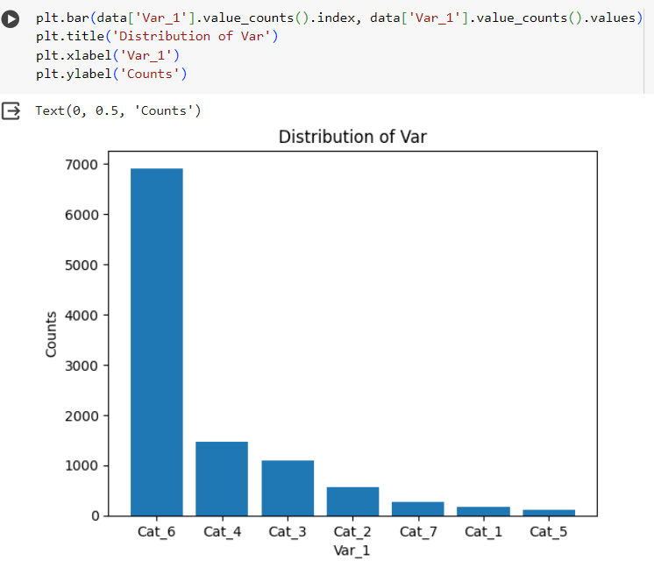
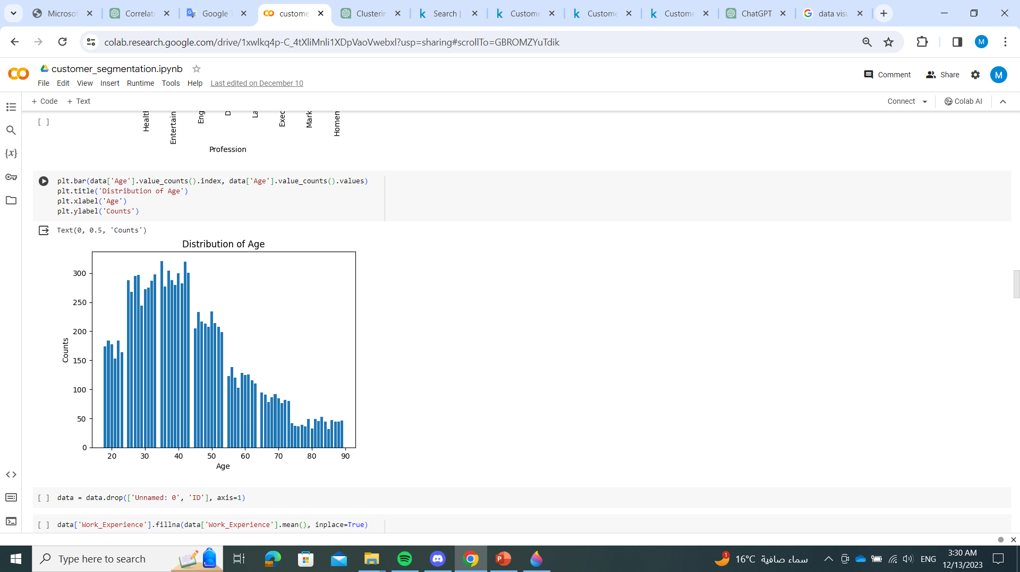

Slide 9
Data Preprocessing
data = data.drop(['Unnamed: 0', 'ID'], axis=1) , removing unnecessary columns
data['Work_Experience'].fillna(data['Work_Experience'].mean(), inplace=True) , fills missing values in the 'Work_Experience' column with the mean of the non-missing values in that column.
data.dropna(inplace = True) , drops rows with any missing values from the 'data' DataFrame
data = data.drop('Segmentation', axis=1) ,drop this column because it is the target
label_encoder = LabelEncoder() ,encode categorical labels with numerical values
for col in data.select_dtypes(include=['object']).columns: data[col] =label_encoder.fit_transform(data[col]) convert categorical data into a format that can be used by machine learning algorithms. Label encoding assigns a unique integer to each category in a column.
scaler = StandardScaler() , to standardize (scale) numerical columns in the DataFrame
numerical_cols = data.select_dtypes(include=['float64', 'int64']).columns data[numerical_cols] = scaler.fit_transform(data[numerical_cols]) ensures that each feature contributes approximately equally to the model's learning process
data_scaled = pd.DataFrame(scaler.fit_transform(data), columns = data.columns) to create a version of the data where all numerical features have a mean of 0 and a standard deviation of 1.

Slide 10
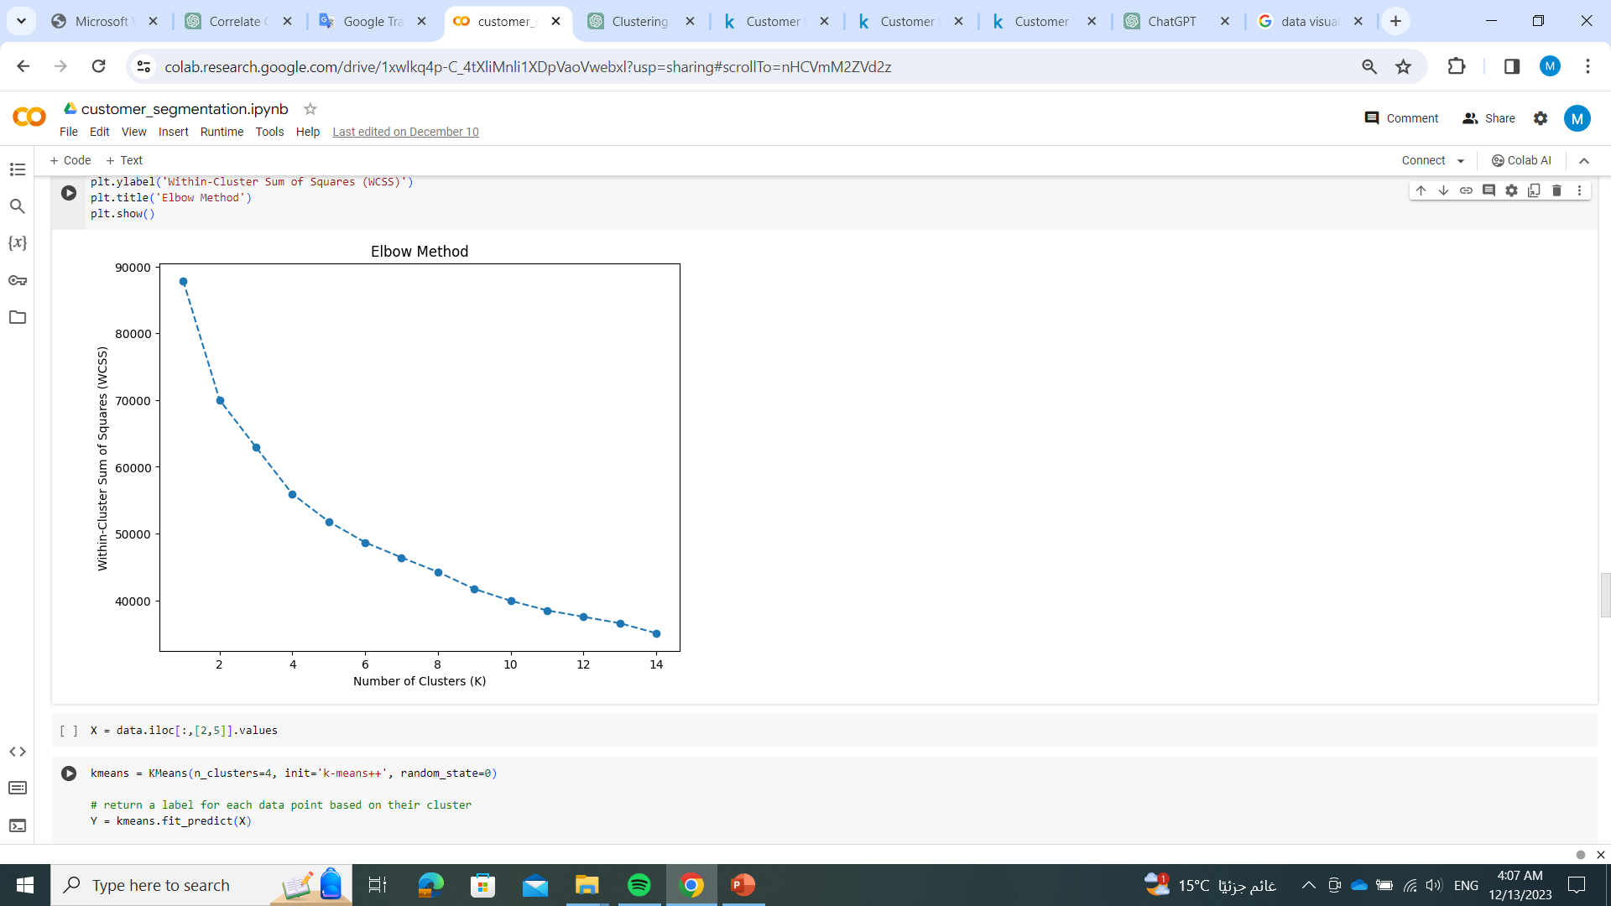
Clustering
wcss = []
for i in range(1, 15): kmeans = KMeans(n_clusters=i, init='k-means++', random_state=42) kmeans.fit(data) wcss.append(kmeans.inertia_) performing the "Elbow Method" to determine the optimal number of clusters (k) for the K-Means clustering algorithm
plt.figure(figsize=(8, 6)) plt.plot(range(1, 15), wcss, marker='o', linestyle='--') plt.xlabel('Number of Clusters (K)') plt.ylabel('Within-Cluster Sum of Squares (WCSS)') plt.title('Elbow Method') creating a plot to visualize the within-cluster sum of squares (WCSS) for different values of k in the K-Means clustering algorithm.

Slide 11
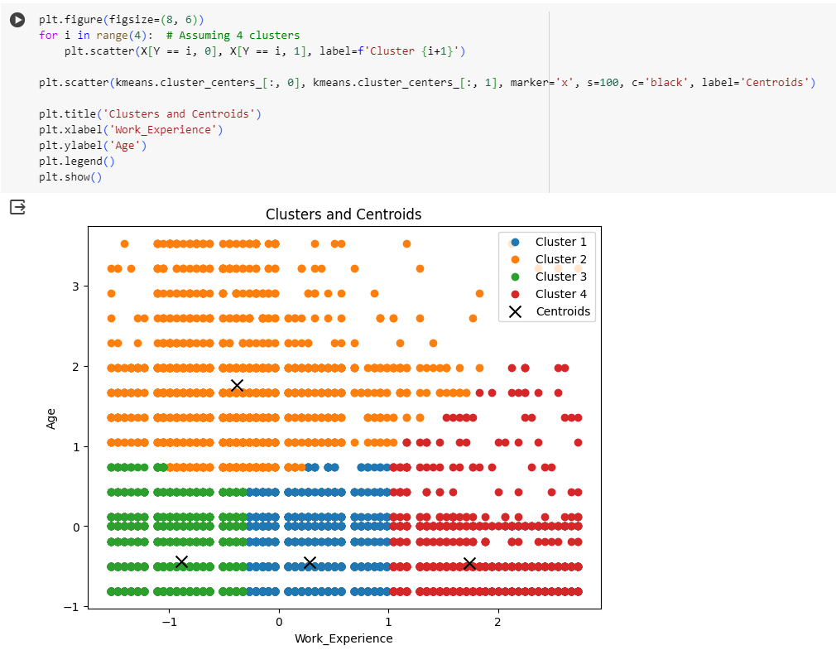
Evaluating model
X = data.iloc[:,[2,5]].values is creating a new variable X
kmeans = KMeans(n_clusters=4, init='k-means++', random_state=0) Y = kmeans.fit_predict(X) ,method of the KMeans model is used to fit the model to the data (X) and simultaneously return the cluster labels for each data point
data['Cluster'] = kmeans.fit_predict(X) , assigning cluster labels to the original DataFrame 'data' based on the K-Means clustering results
cluster_means = data.groupby('Cluster').mean() print("Mean values per cluster:") print(cluster_means), calculating the mean values of each numerical column in the DataFrame 'data' grouped by the 'Cluster' column

Slide 12
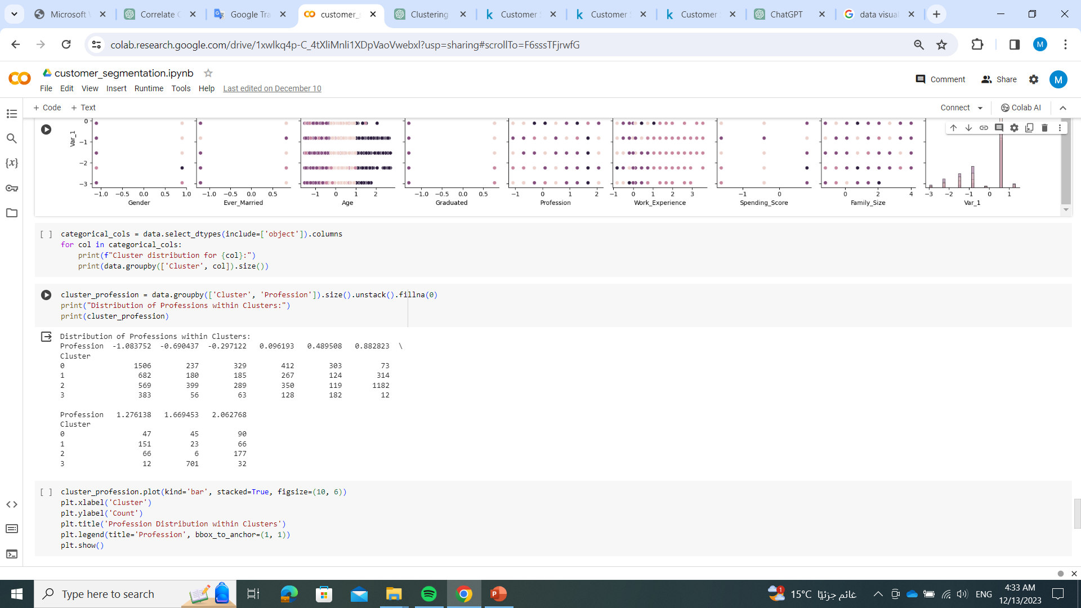
Visualization model
sns.pairplot(data, hue='Cluster', diag_kind='hist') plt.show(), creating a pair plot using Seaborn to visualize the relationships between numerical features in the DataFrame 'data' while considering the assigned cluster labels
categorical_cols = data.select_dtypes(include=['object']).columns for col in categorical_cols: print(f"Cluster distribution for {col}:") print(data.groupby(['Cluster', col]).size()), code is analyzing the distribution of categorical variables within each cluster. It uses a loop to iterate over each categorical column in the DataFrame 'data' and prints the count of occurrences for each category within each cluster.
cluster_profession = data.groupby(['Cluster', 'Profession']).size().unstack().fillna(0) print("Distribution of Professions within Clusters:") print(cluster_profession), creating a contingency table to show the distribution of professions within each cluster.

Slide 13
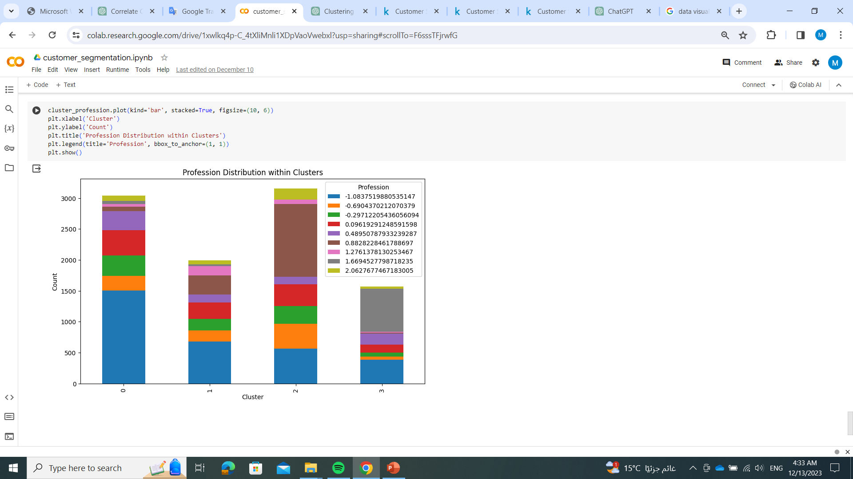
Refinement and Application
cluster_profession.plot(kind='bar', stacked=True, figsize=(10, 6)) plt.xlabel('Cluster') plt.ylabel('Count') plt.title('Profession Distribution within Clusters') plt.legend(title='Profession', bbox_to_anchor=(1, 1)) plt.show(), creating a stacked bar plot to visually represent the distribution of professions within each cluster. It utilizes the contingency table previously created

